Slide 1
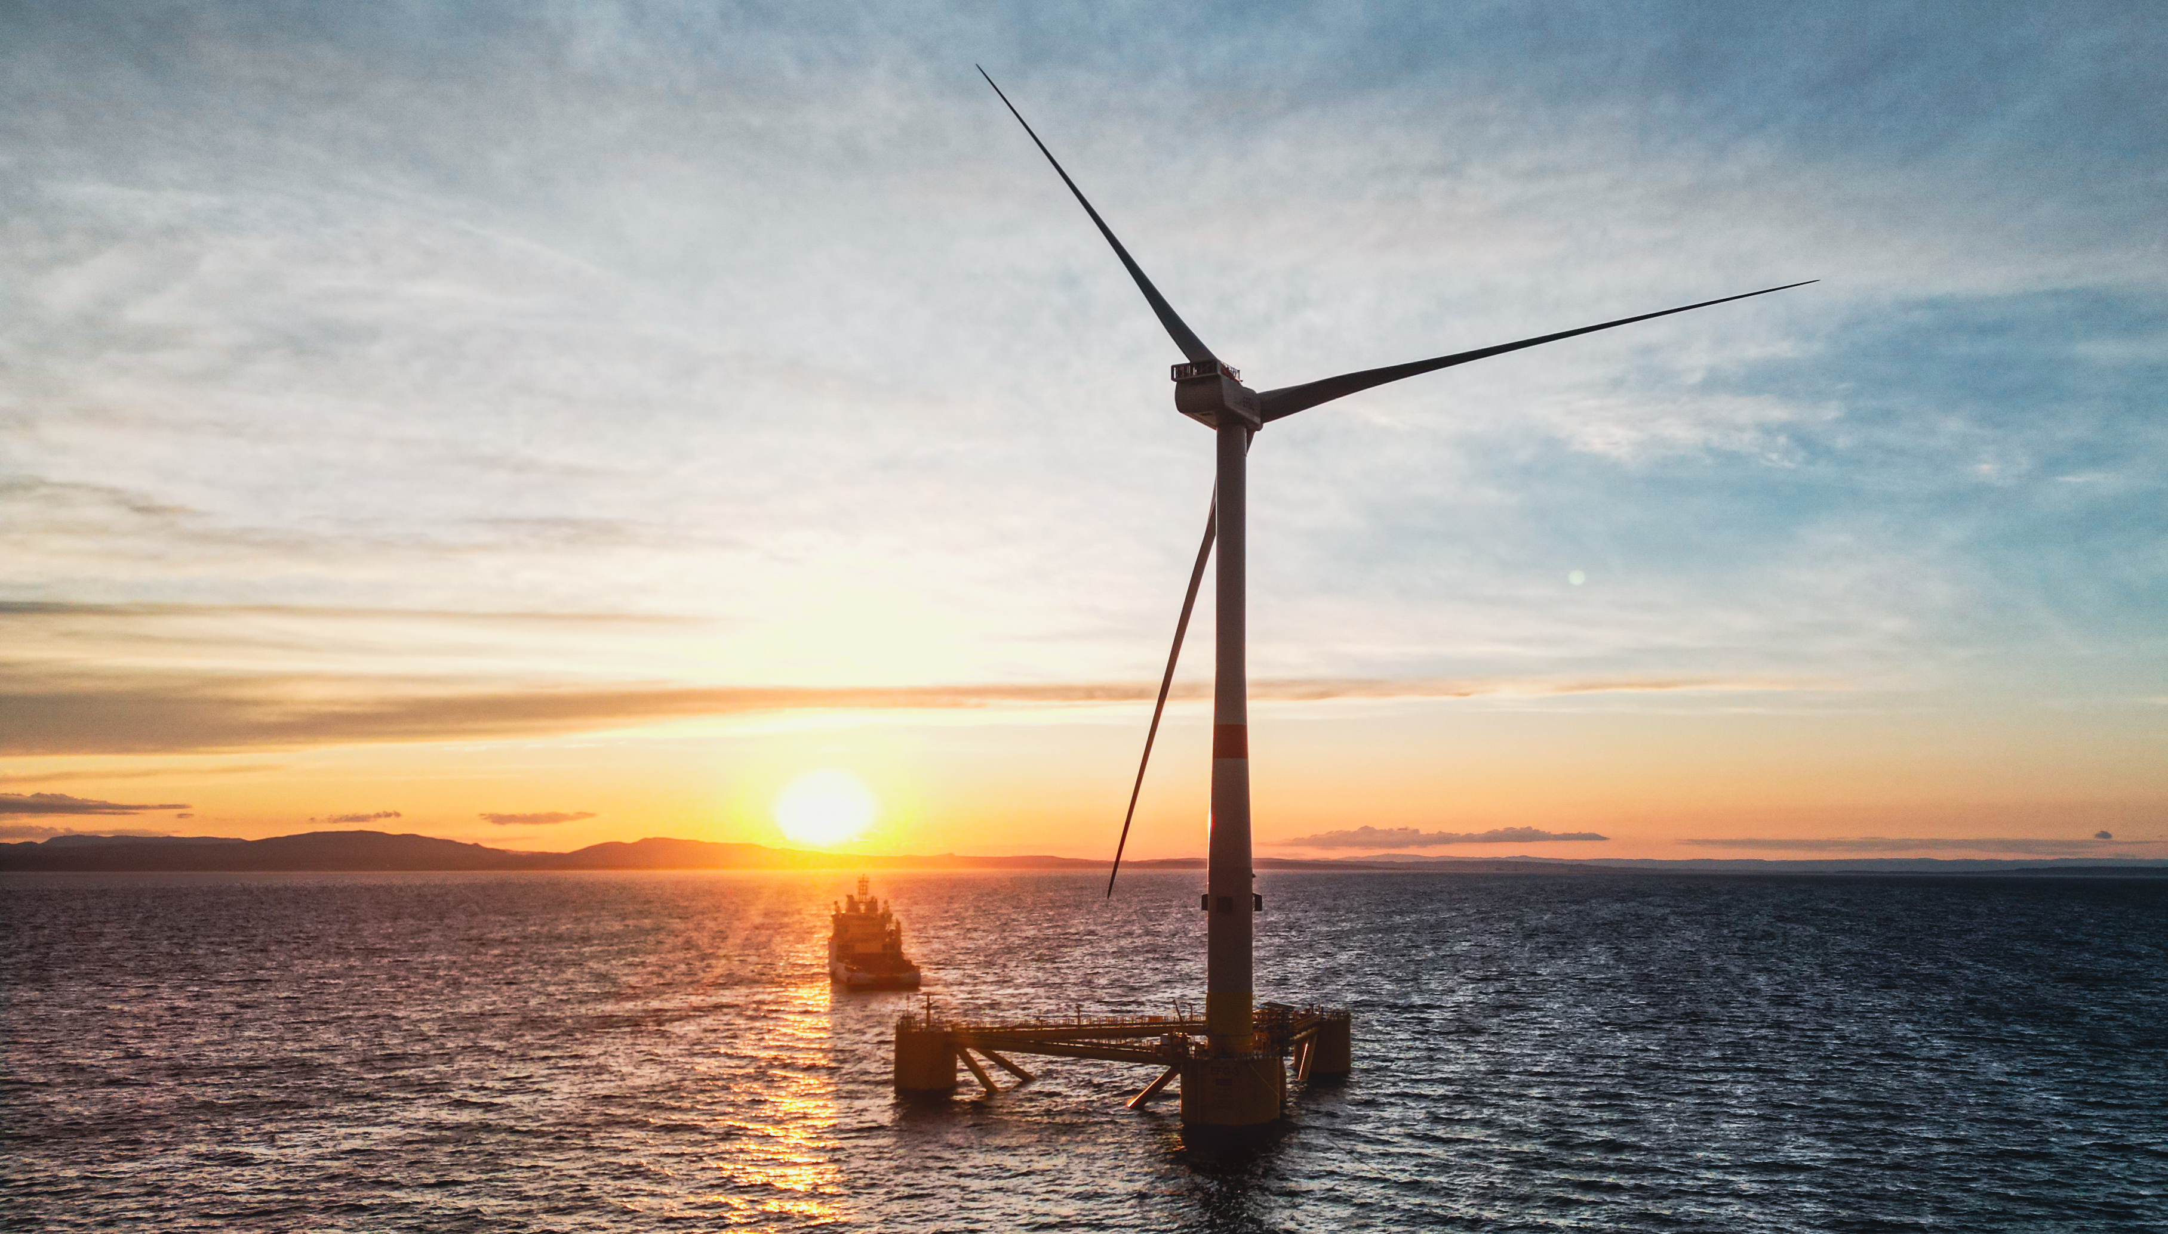

Design and Installation of Synthetic Rope Moorings
Moorings and Anchor Conference & Workshop

Slide 2
CONTENTS
Tadek Overview
Synthetic Rope Moorings
Installation and Hook-up Experience
Conclusions and Perspectives

Slide 3
Tadek Overview

Slide 4
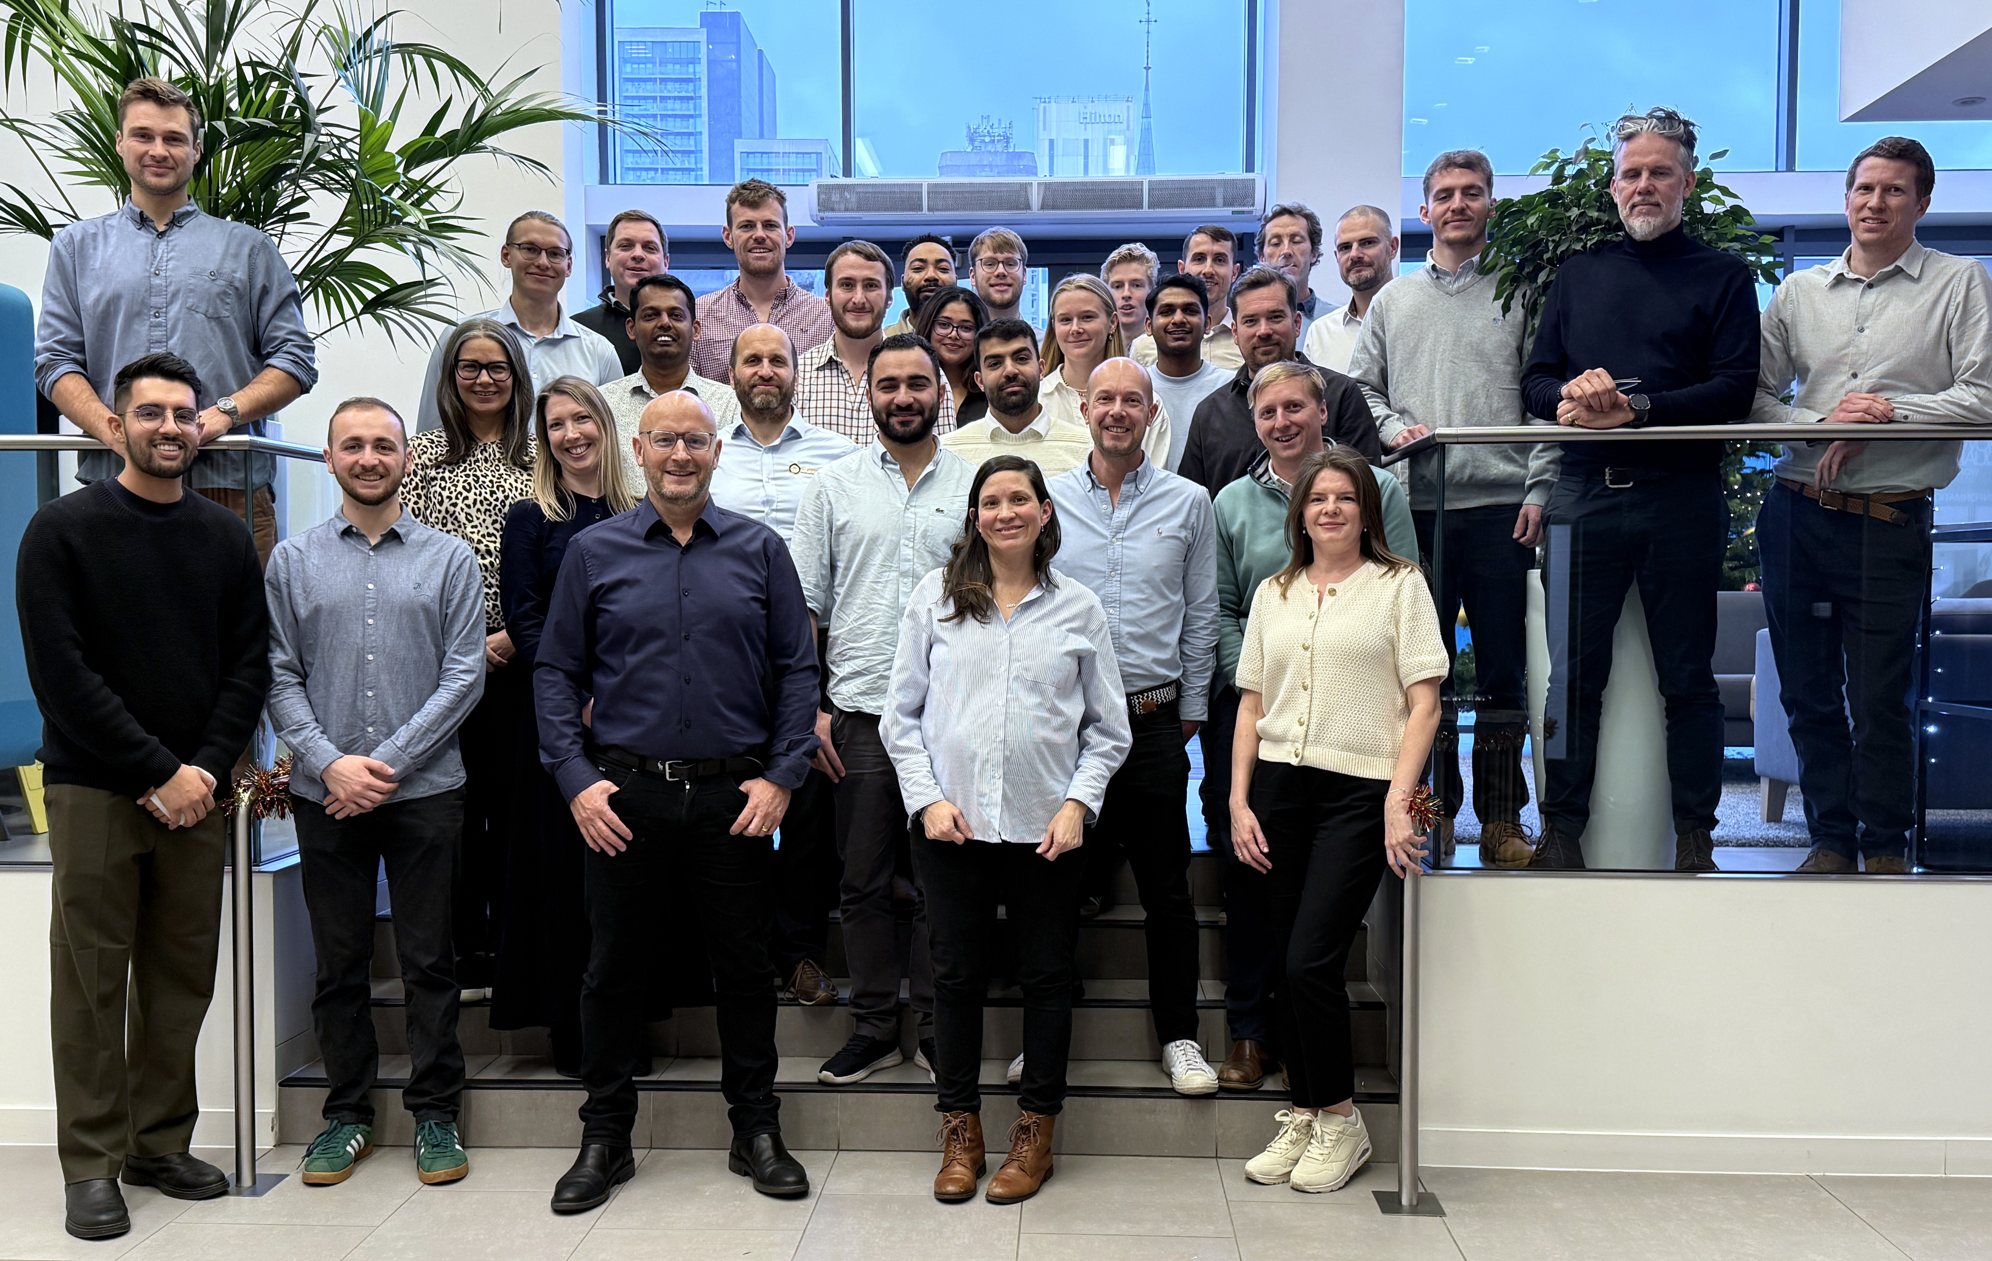
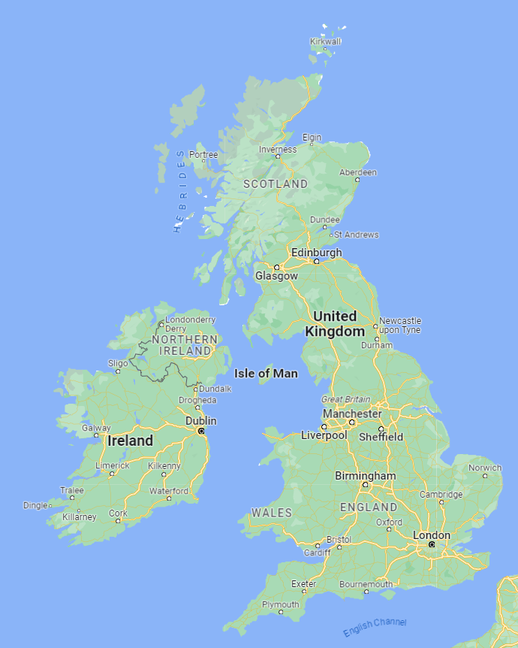
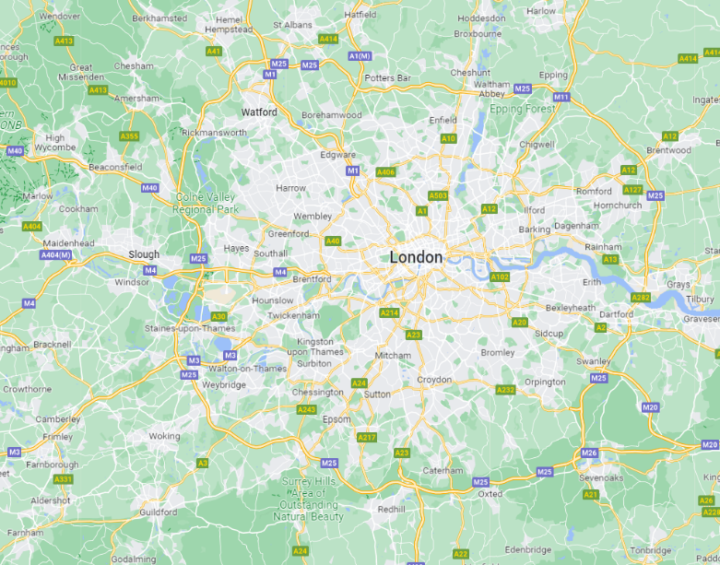
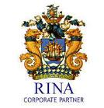
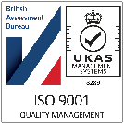
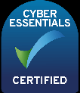
Introduction to Tadek
Tadek
    Dynamic design & engineering consultancy established 2010.
    HQ in Woking, UK with a team of ~35 permanent staff.
    Over 300 projects worldwide (Europe, Africa, Americas, APAC).
    Expertise in traditional O&G to cutting edge renewable energy.
    Specialist partners (e.g. CFD, Geotech).
    ISO9001 Quality Management Certified UKAS BAB.
London

Slide 5
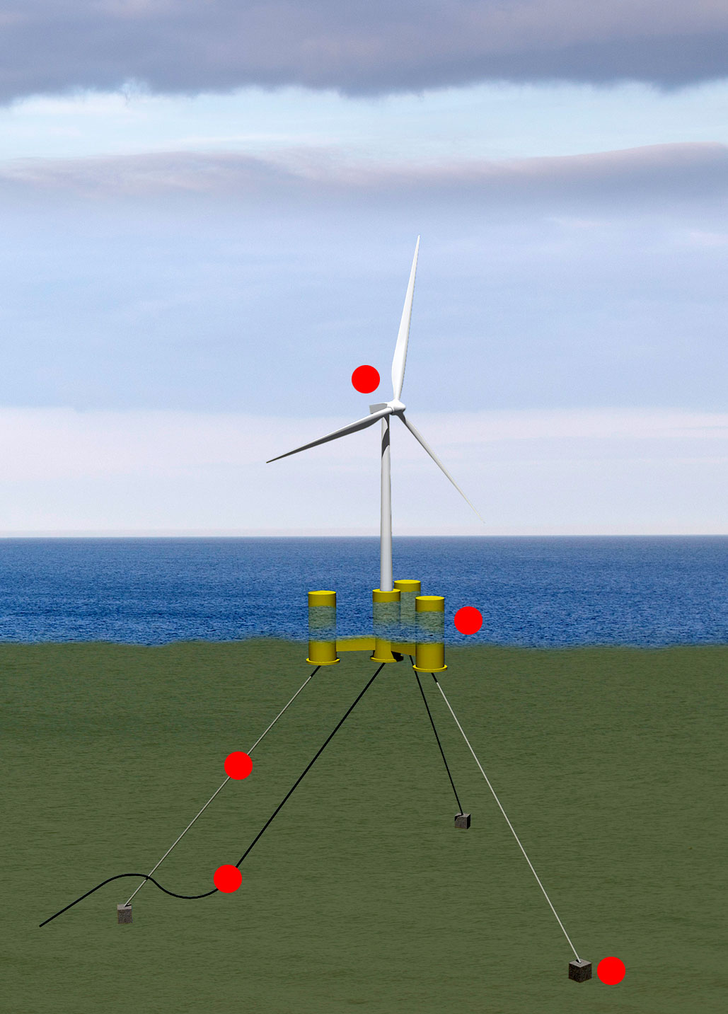
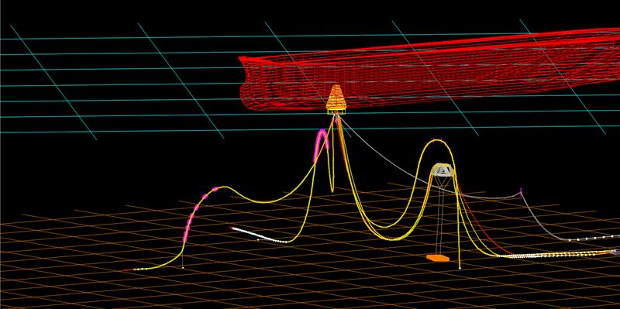
Capabilities
Advisory
    Field Development
    Owners Engineering
    Risk Analysis
    Technical Due Diligence
Ocean Projects
    Project Management
    Project Planning
    Project Engineering
    QHSE
Ocean Engineering
    Naval Architecture
    SURF & Cables
    Design & Structural Engineering
    Installation Analysis
    Mooring, FOW & Floating Systems

Slide 6
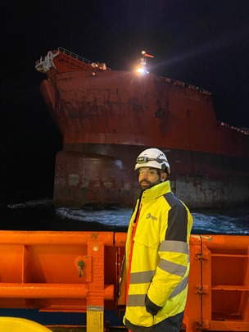
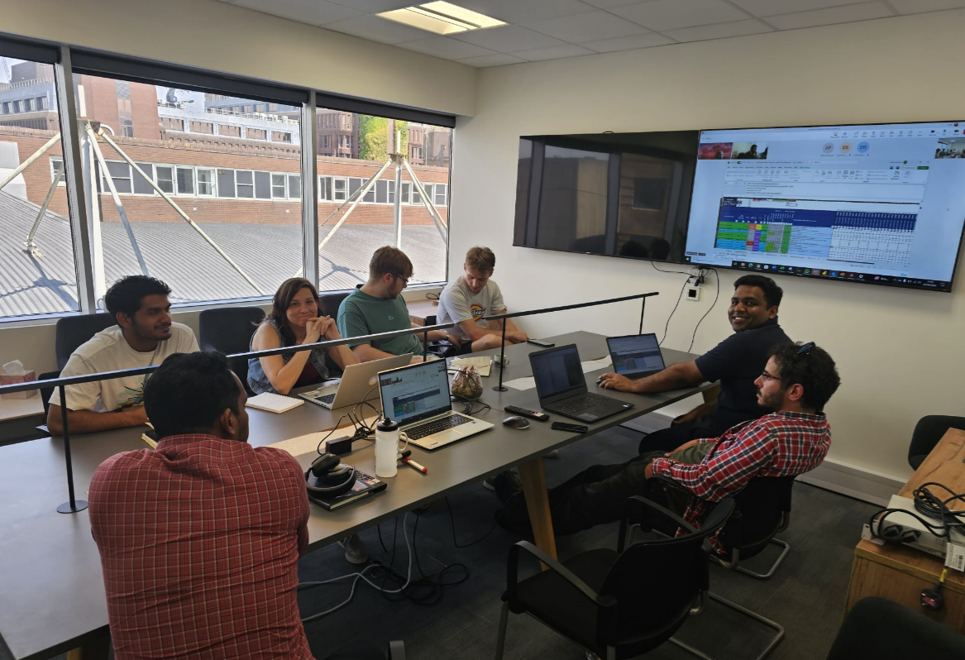
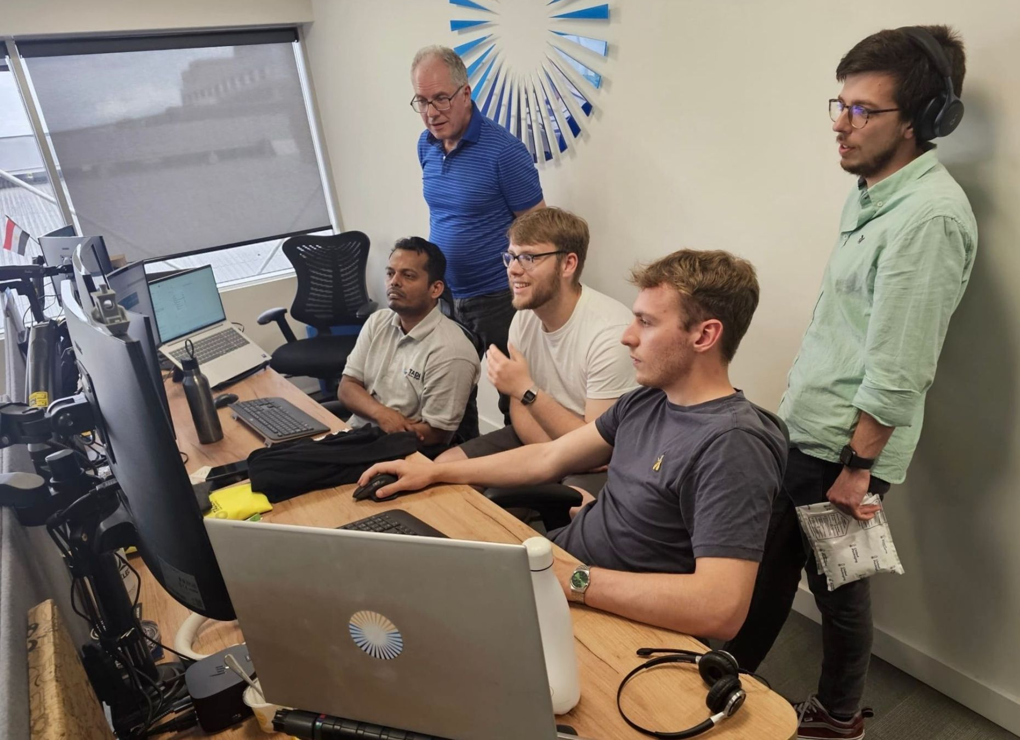
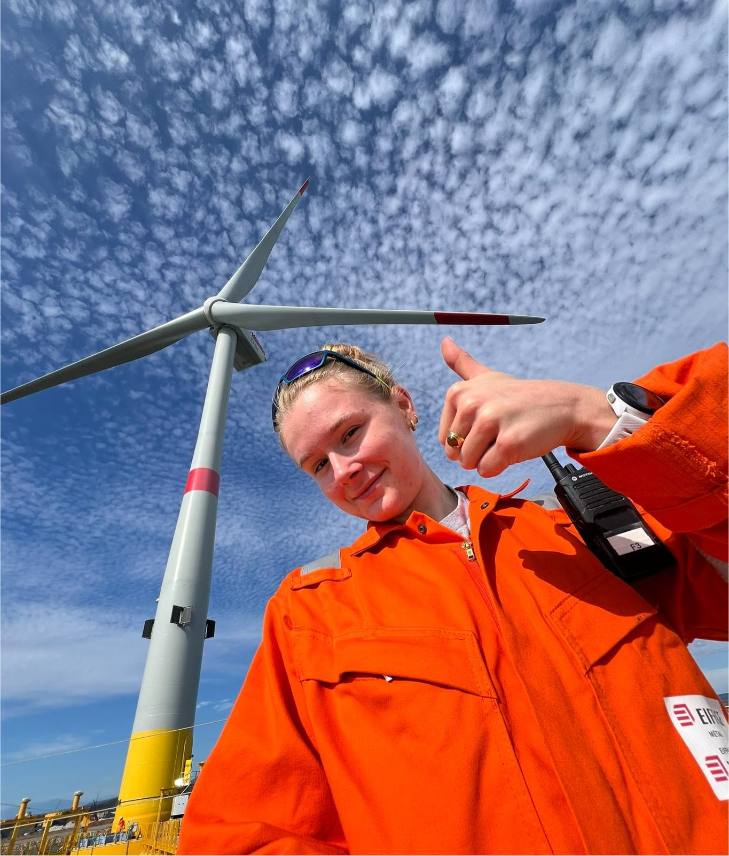
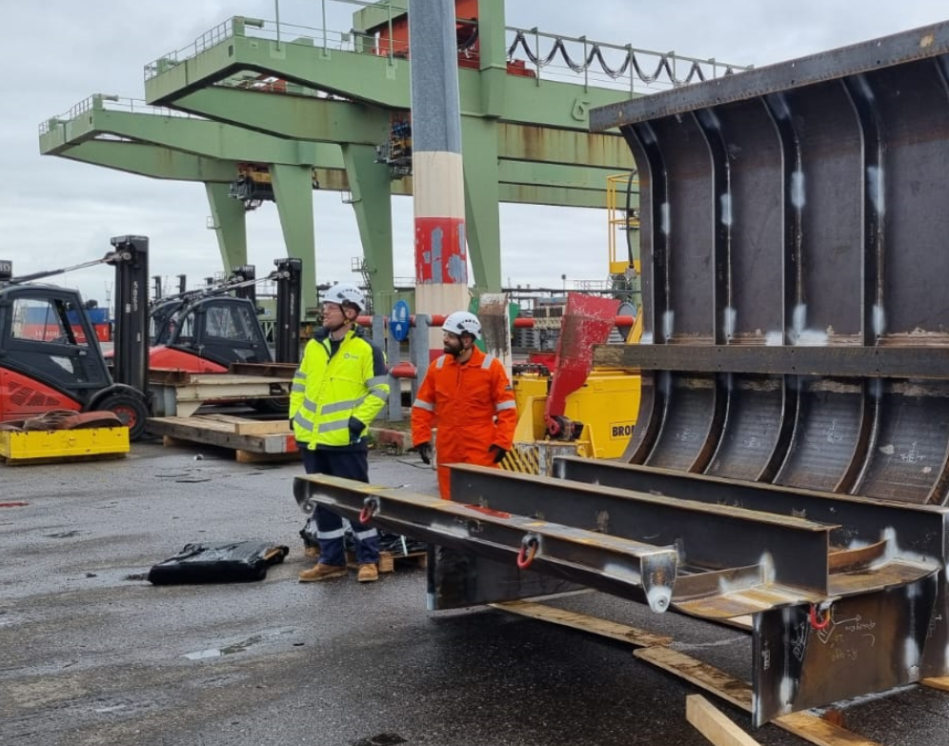
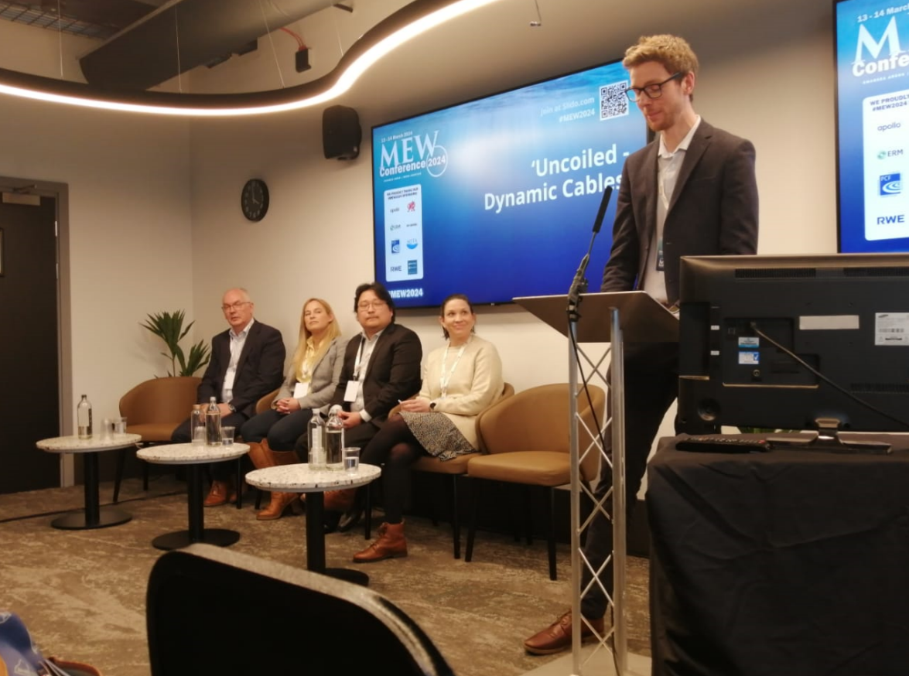
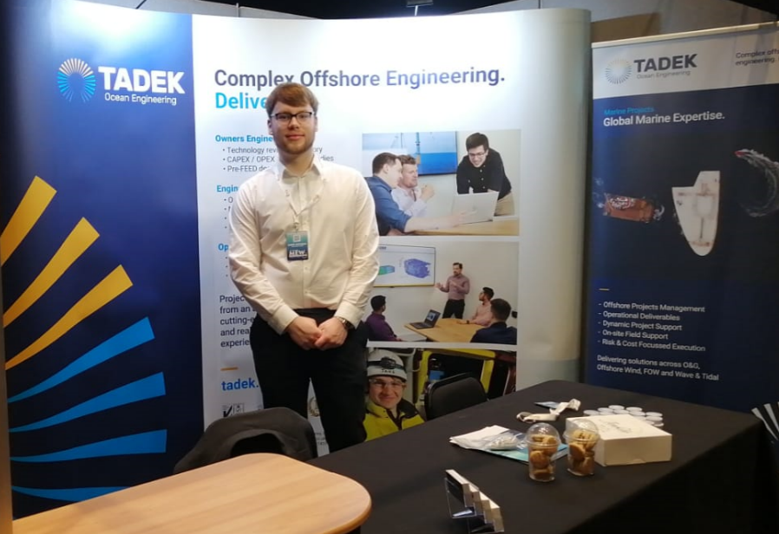
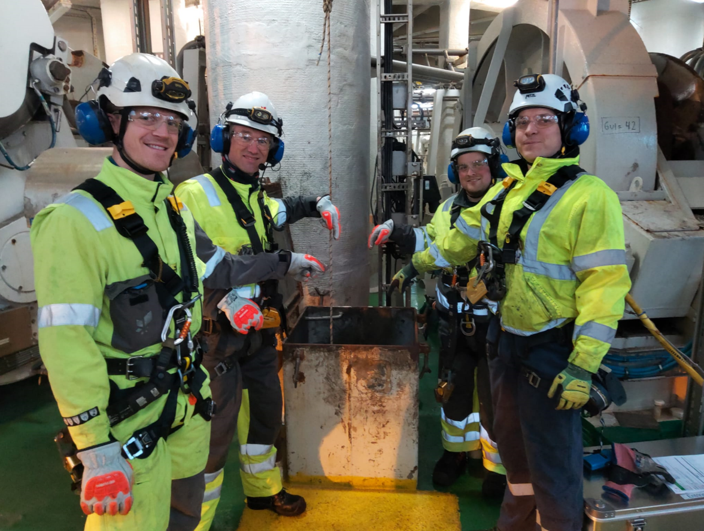
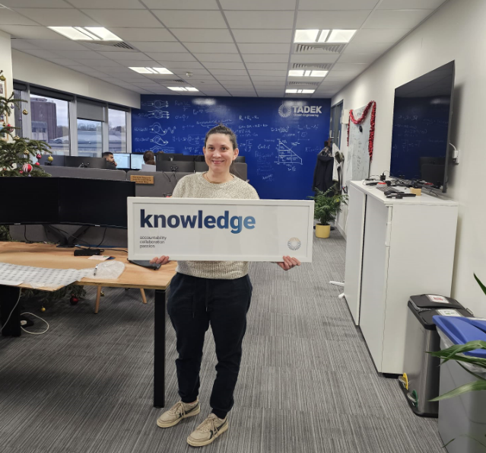
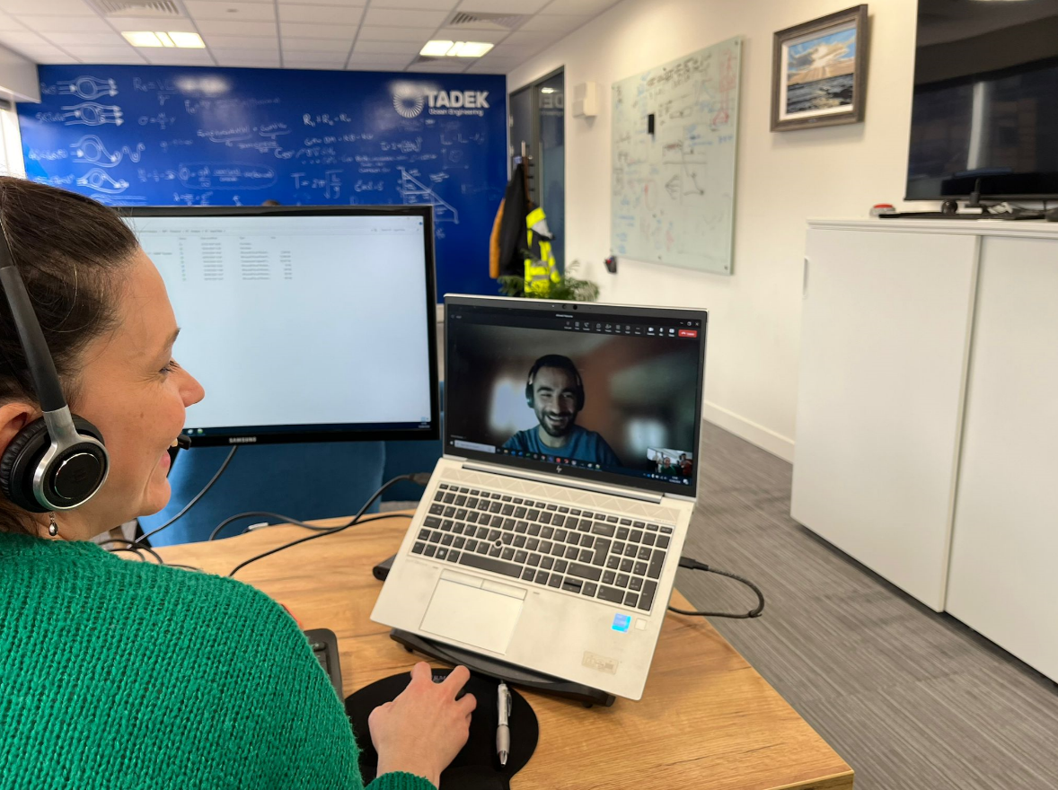
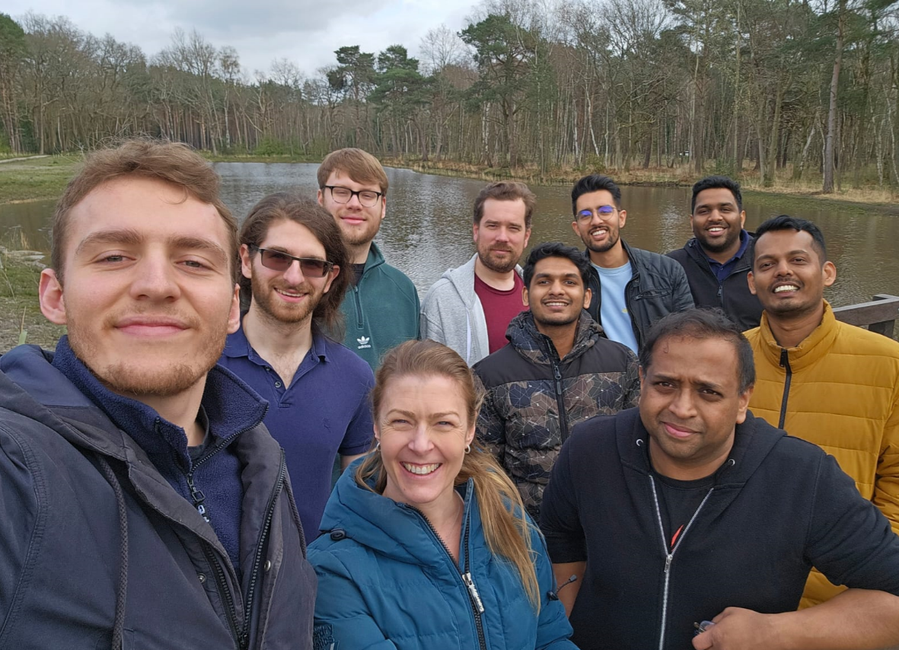
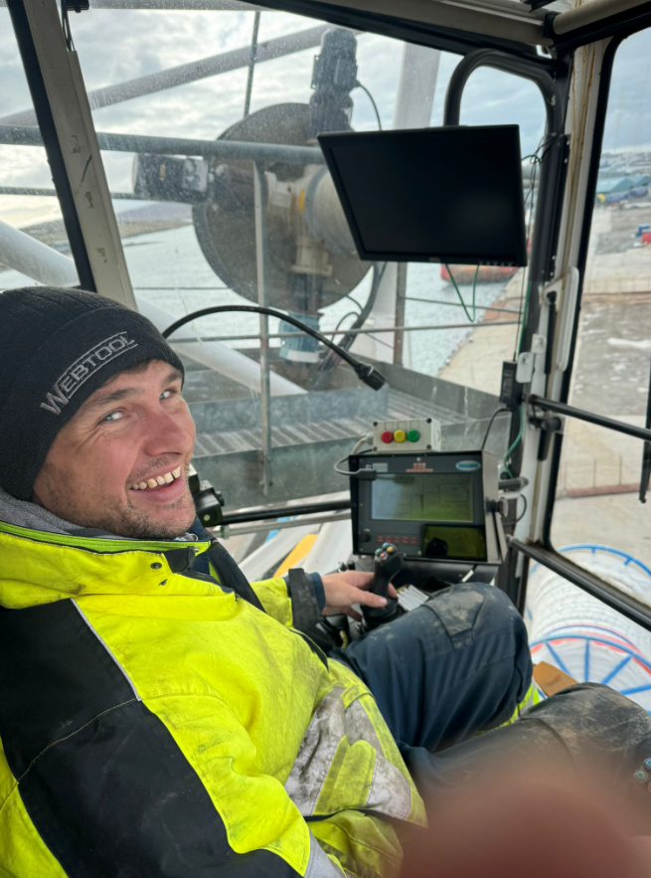
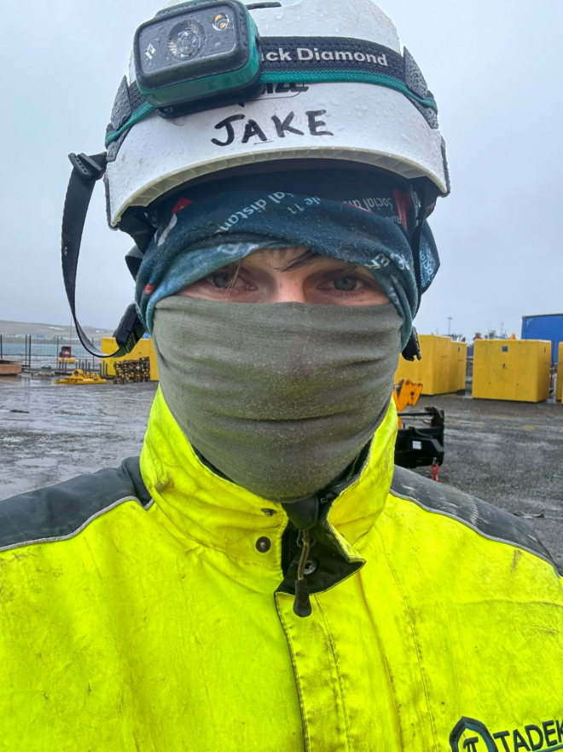
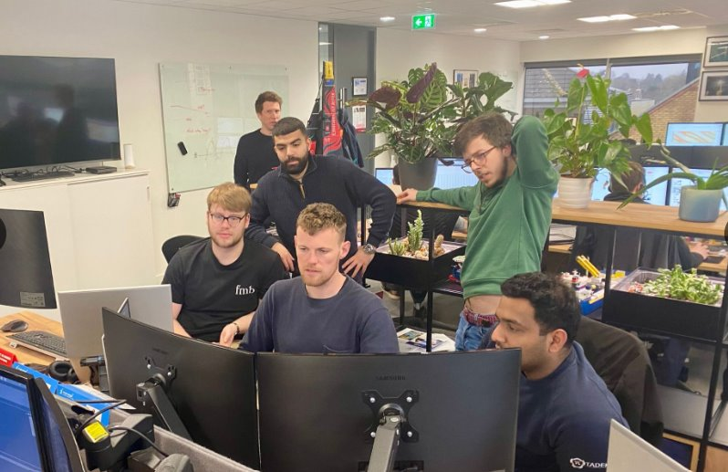
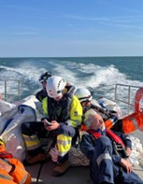
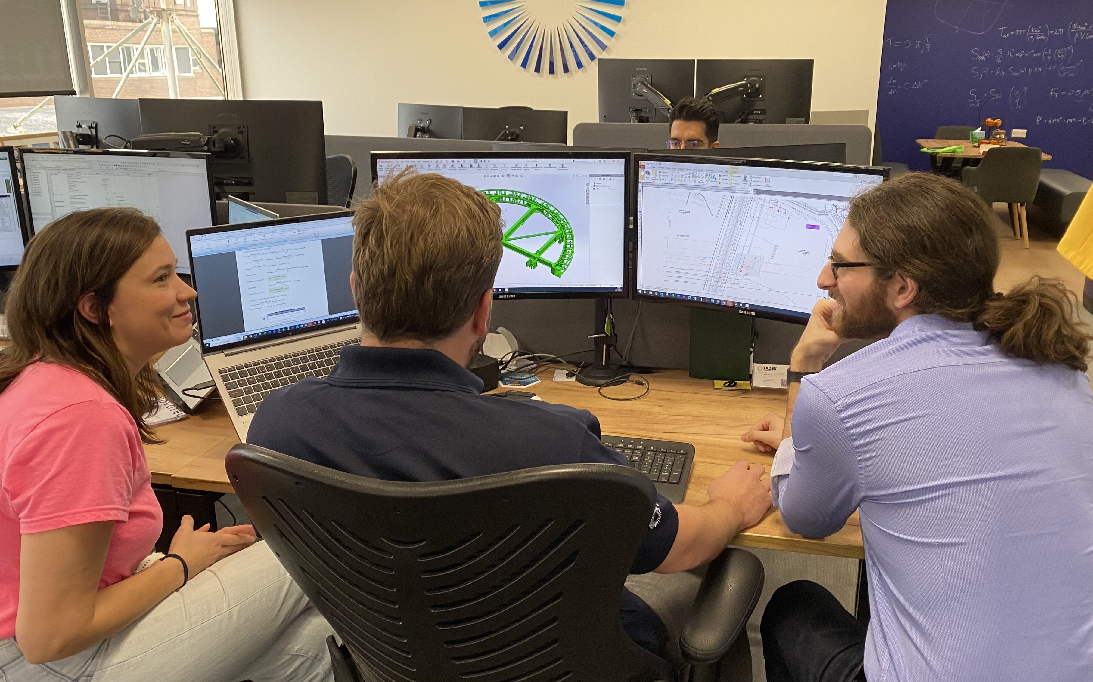
One Team – Two Disciplines

Slide 7
Synthetic Rope Moorings

Slide 8
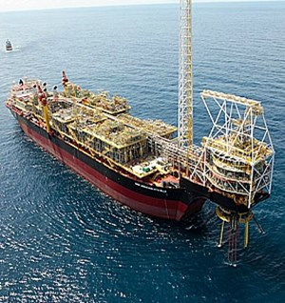
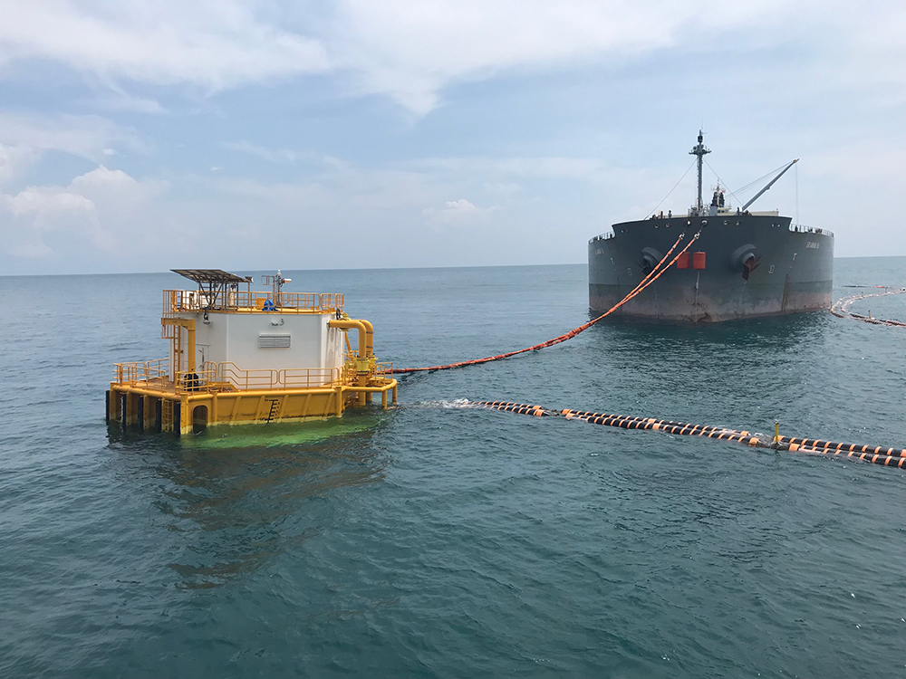
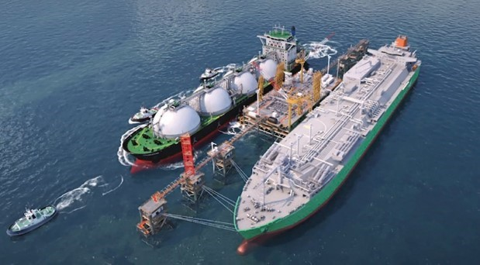
Synthetic Ropes in Offshore Energy
Synthetic ropes used traditionally in offshore energy projects with different conditions:
Deep water mooring of production platforms (polyester)
Tanker mooring to SPM systems (nylon)
Quayside and Ship-To-Ship mooring of tankers and LNGCs (HMPE)
Increasingly the primary choice for the mooring systems of FOWTs because suitable to taut and semi-taut systems with advantages over catenary systems:
Lighter weight
Better compliance and load response
Durability
Low cost

Slide 9
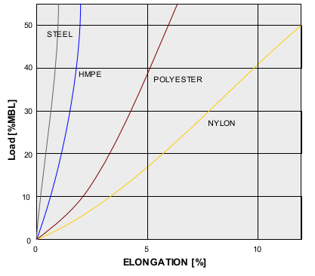
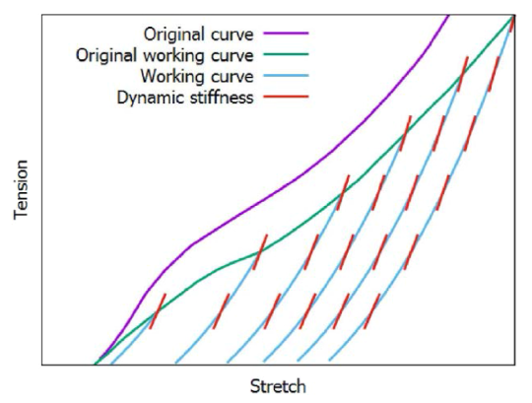
Synthetic Rope Properties
Different types of synthetic ropes have different properties:
HMPE -> high strength and high stiffness, creep-sensitive
Polyester -> mid-range stiffness, limited creep, low cost
Nylon -> large elongation, long-term usage not proven
Courtesy of Bridon-Bekaert
Both polyester and nylon subject to adjustments in the line length due to stretching
Loading follow a hysteresis, according to the Syrope model
Nylon prone to significant stretching after the hook-up, requiring different steps of re-tensioning operations
DNV “Syrope” Model – Falkenberg et al., 2017

Slide 10
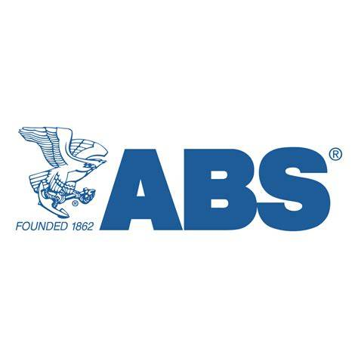
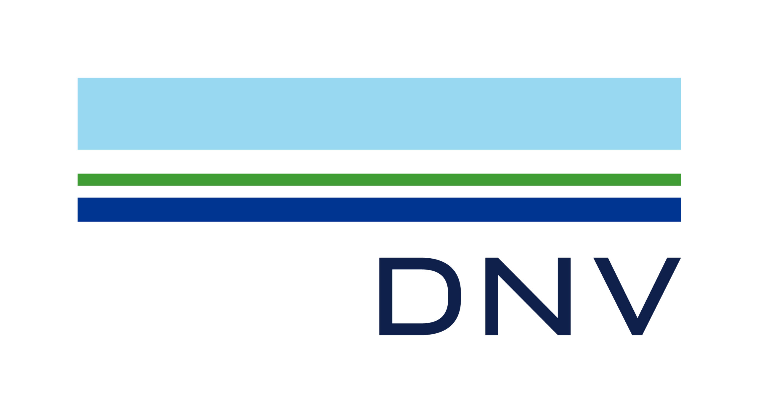

Standards and Industry Guidance
Most existing projects employ a hybrid mooring line design:
Top steel segment (typically chain to facilitate length adjustment)
Fibre rope segment/s (may be multiple for manufacturing and handling)
Bottom steel segment (chain or wire to connect to the anchor)
Guidance from industry standards (ABS, BV, DNV) building on past O&G deep water experience aligned on:
Dynamic stiffness formulation
Protective cover against damage and particle ingress
Creep monitoring for re-tensioning (where applicable)
Avoidance of seabed contact
Potential increase in SFs (e.g. BV and ClassNK)
Nylon suitability to permanent moorings still under investigation and qualification – most standards refer to polyester / HMPE as basecase

Slide 11
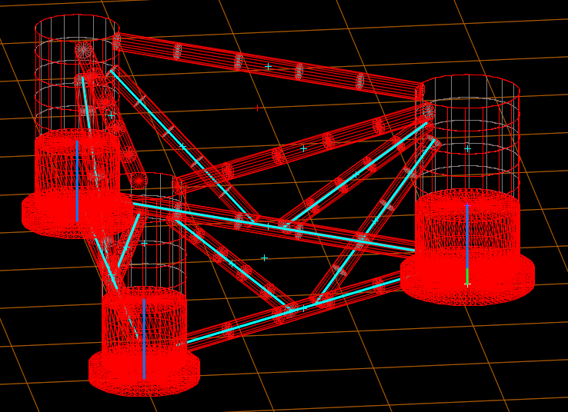
Case Study – Design of Synthetic Moorings for FOWT
Design of a mooring system for a Floating Wind Semisubmersible, considering water depths of 70m and 120m
Main criteria:
Design life of 30 years + 2yrs for installation / decom
Mooring line loads SFs according to ABS
Clearances of rope sections and buoyancy modules
Max offsets within 40%WD
Asymmetric semisubmersible design with 3 columns, with corner WTG
Mooring hang-off below the heave plates
Loading Condition | Redundancy of the system | Design condition of the System | Safety Factor
Design Load Cases | Redundant | Intact | 1.67
 |  | Damaged condition with one broken line | 1.25
 |  | Transient condition with one broken line | 1.05
 | Non-redundant | Intact | 2.00
Survival Load Cases | Redundant or Non-redundant | Intact | 1.05

Slide 12
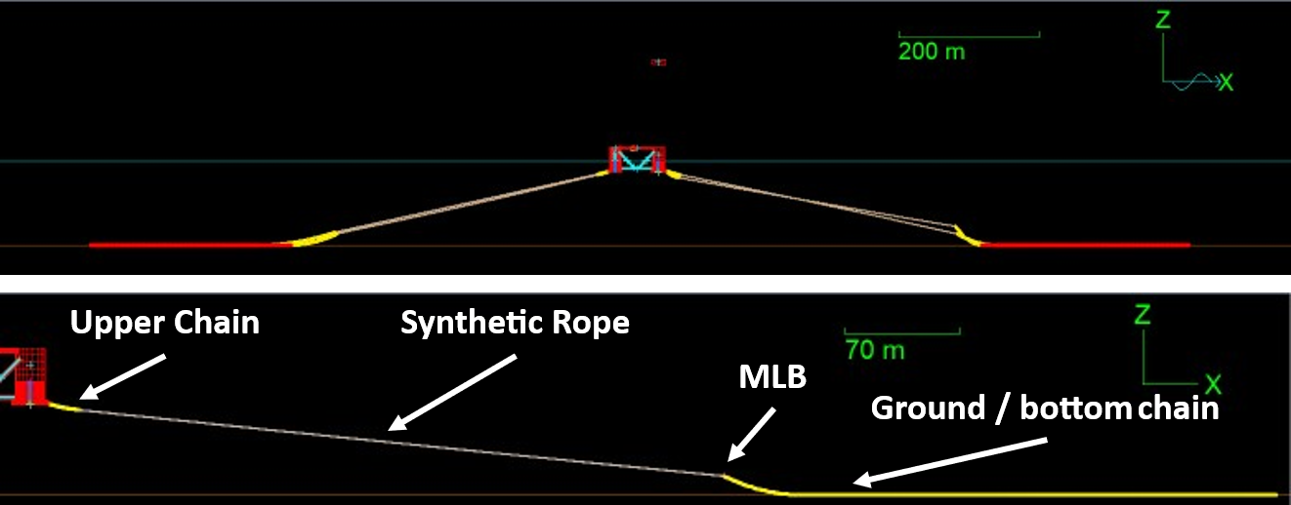
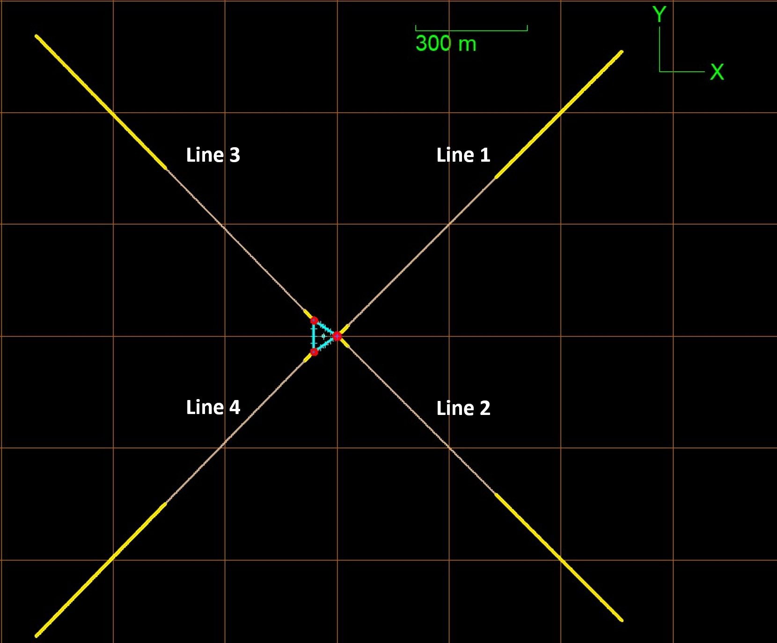
Case Study – Design of Synthetic Moorings for FOWT
4-lines symmetrical mooring system
Requirement for minimum vertical uplift at the anchor leads to:
  Chain top section
  Synthetic Rope mid section (polyester / nylon)
  Chain bottom section to the anchor
Midline buoy of net buoyancy of 30t
Same components between water depths (254mm Polyester vs. 240mm Nylon)
All designs comply with ULS criteria
Nylon reduces loads with similar pretension
System not fully redundant
Water Depth [m] | Synthetic Line type | Max Line Tension [kN] | SF
70 | Nylon | 7741 | 2.45
70 | Polyester | 9070 | 2.09
120 | Nylon | 7429 | 2.55
120 | Polyester | 8586 | 2.21

Slide 13
Installation and Hook-Up Procedures

Slide 14
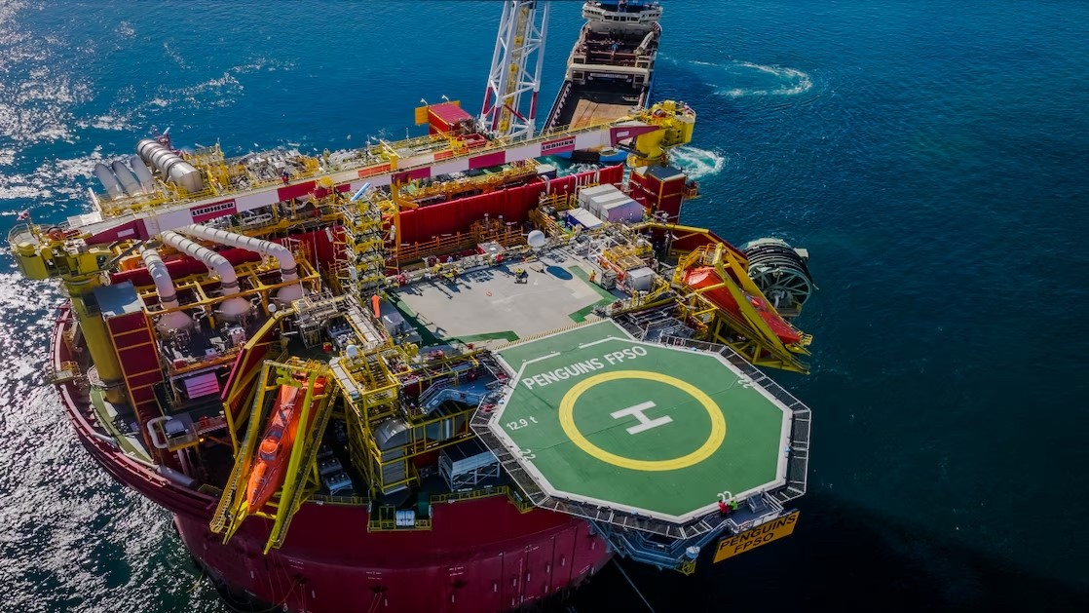
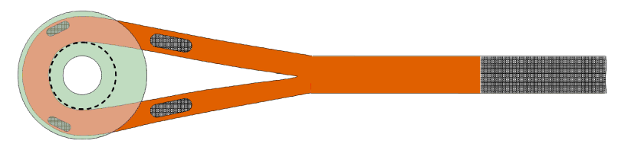
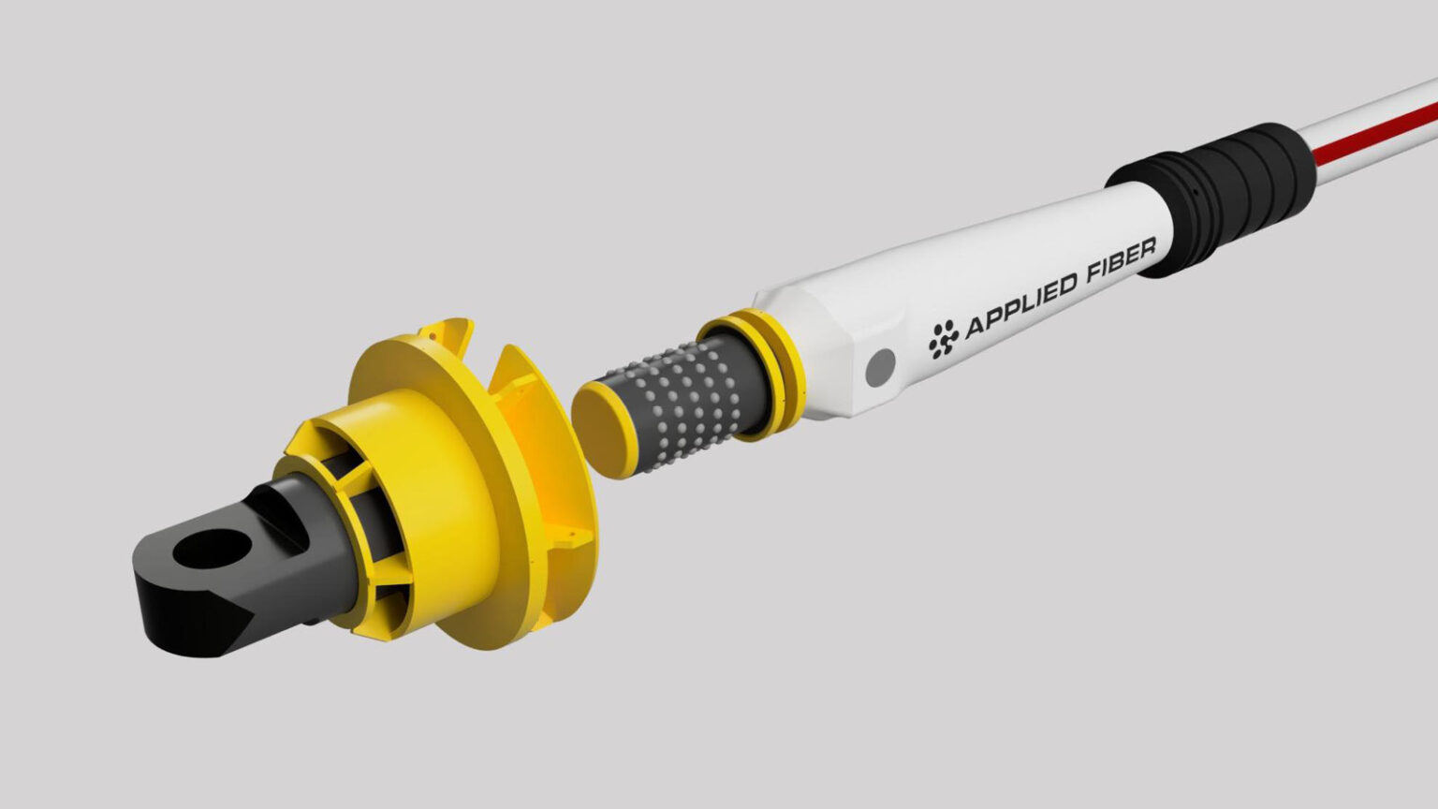
Moorings Installation (Pre-lay and Hook-up)
Mooring installation almost invariably involves anchors pre-laying -> Synthetic ropes often pre-laid with buoyancy elements to keep seabed clearance
Hook-up procedures with polyester or nylon may require applying tension for a long time (e.g. 60 mins) to achieve elongation:
Example: Penguin FPSO applied cross-tensioning across opposite lines using chain stoppers
FOW favours using in-line tensioners (when needed)
Fibre ropes often terminated with spliced eyes fitted on thimbles
Specialist solutions exist for quick connection (e.g. Balltec), some developed for FOW

Slide 15
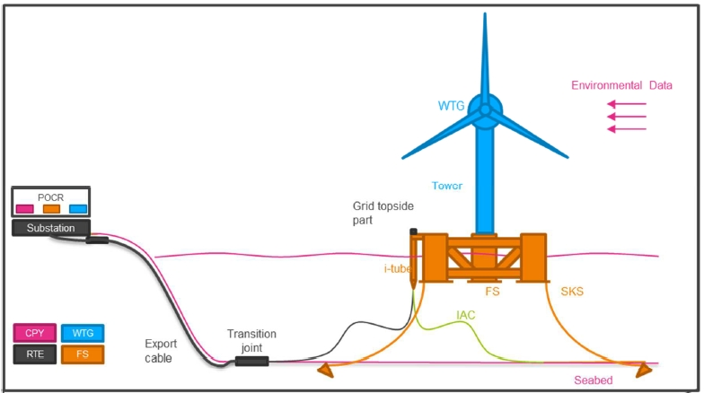
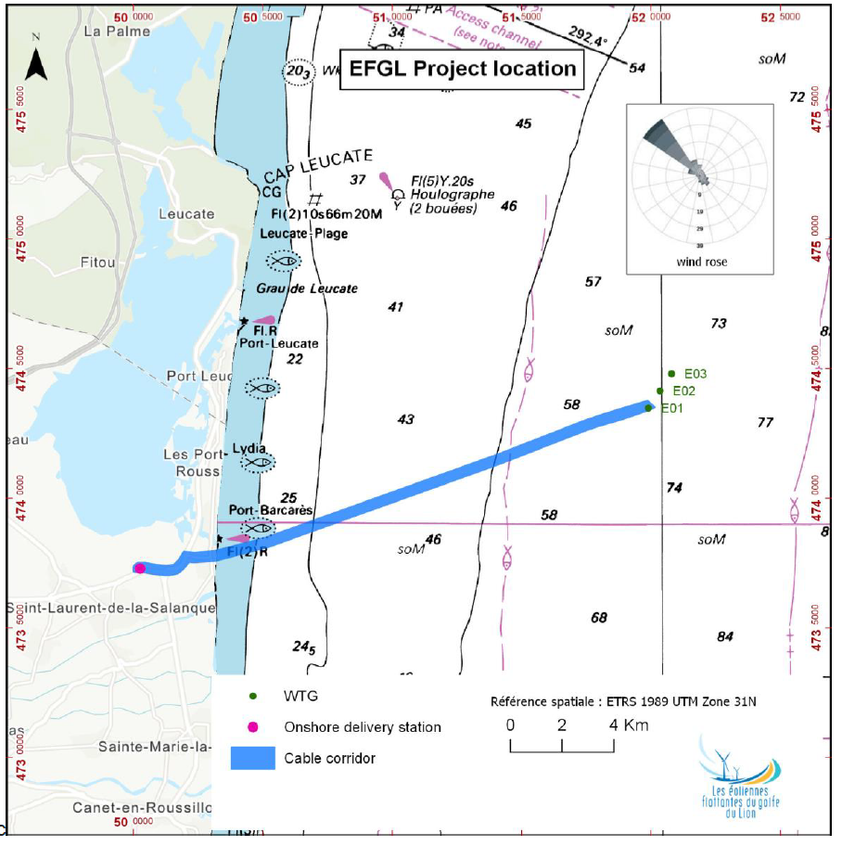
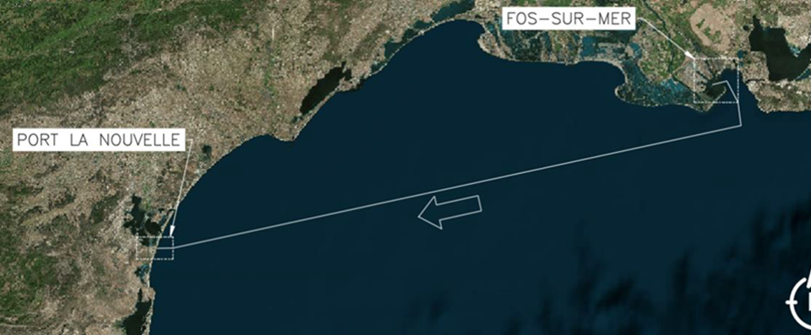
Moorings Installation – Case Study
  EFGL Project Overview
    3x Floating Wind Turbines installed 16km offshore Leucate in Golfe du Lion, France
    Installation complete in summer 2025
    Principle Power WindFloat Floater
    Vestas 10MW Wind Turbine
    ~70m water depth
    Tadek worked with EPCI contractor Eiffage Metal and was involved in all operations below.
Load-out & Float Off
Ballasting
Tow FOS-PLN
Berthing in PLN
WTG Integration
Storage Quay Works
Mooring Prelay Phase 2
Tow PLN-Site
Hook-Up
Ballasting & Diving Works
Mooring Prelay Phase 1

Slide 16
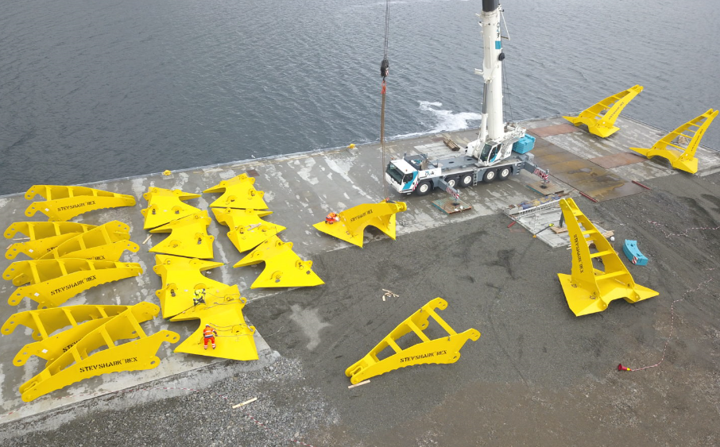
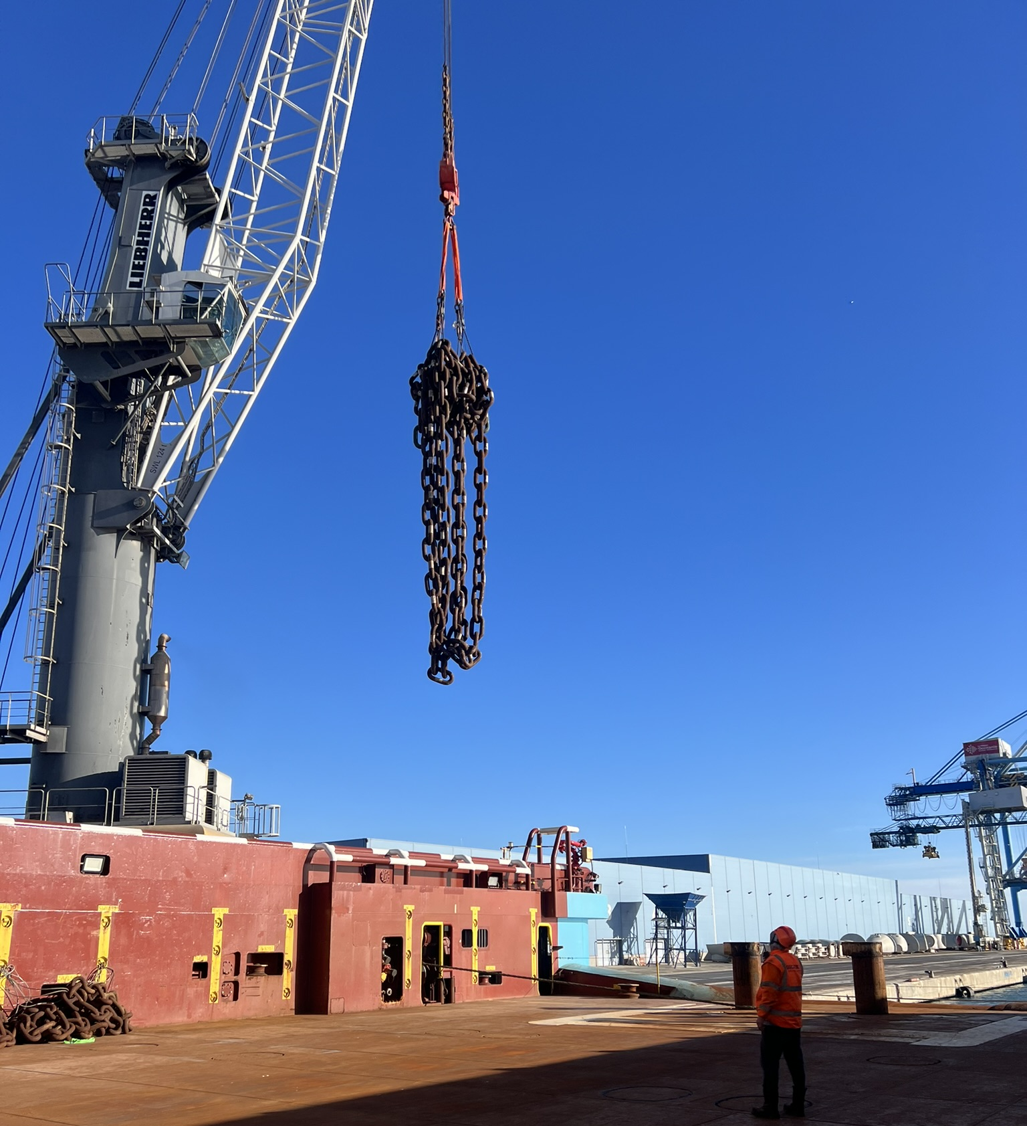
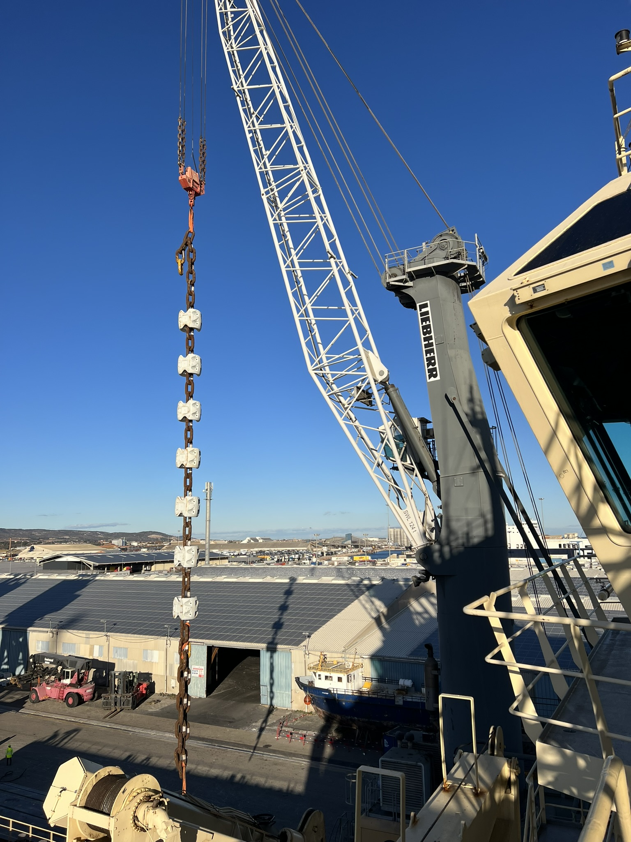
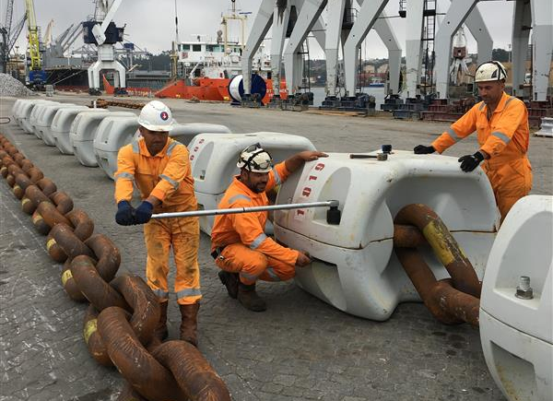
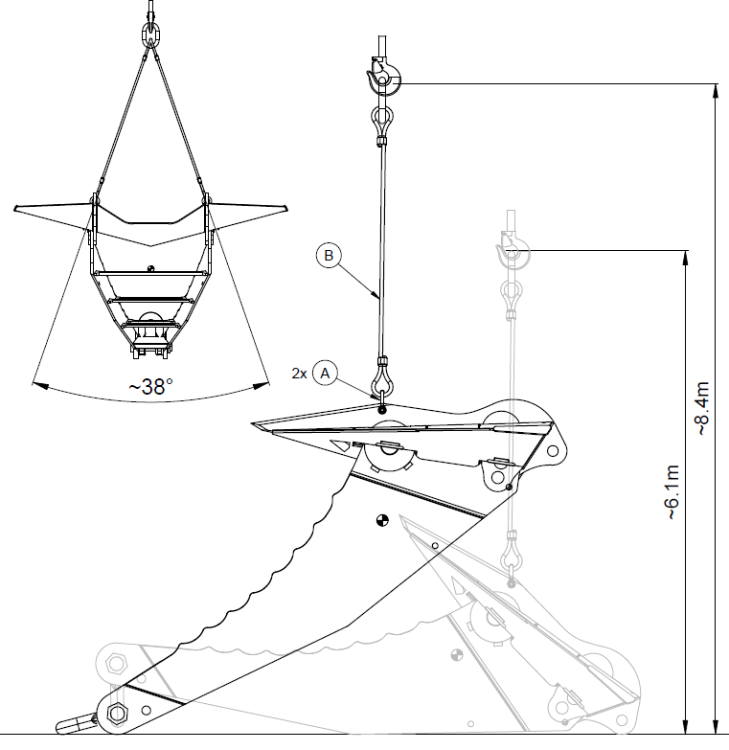
Moorings Installation – Case Study
  Mobilisation Operations
    Prelay Equipment Mobilisation
    Drag Anchor Assembly
    Clump weight assembly
    Chain handling
  Tadek Input
    Mobilisation Planning & Documentations
    Traceability sheets
    On-Site assembly Supervision
    Lift planning
    Port interfacing
16

Slide 17
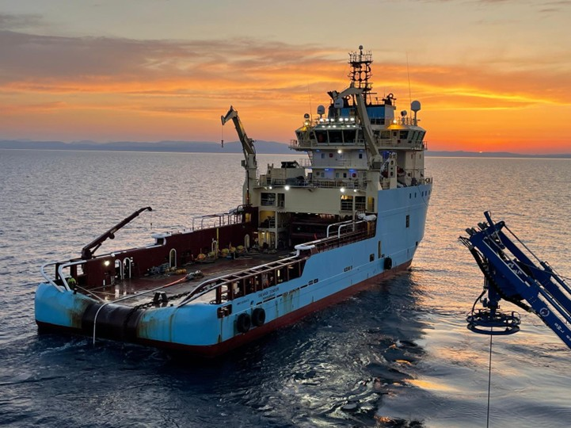
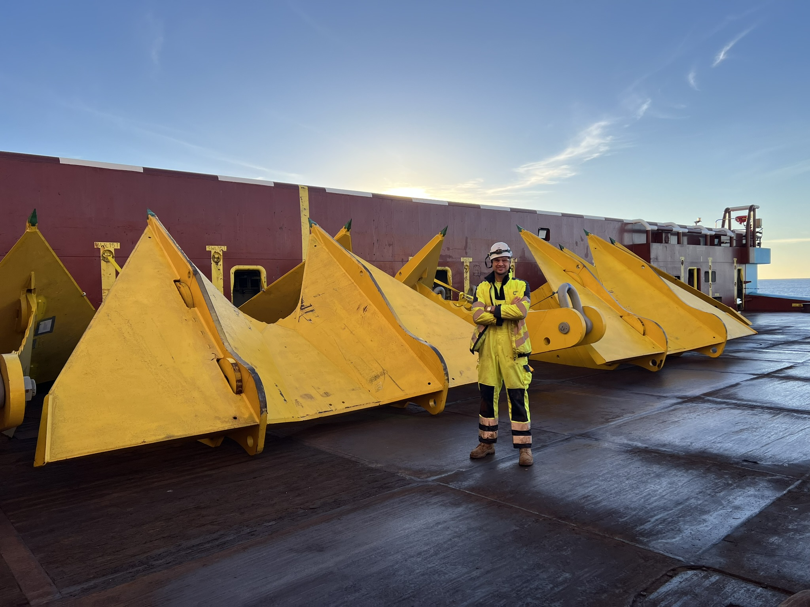
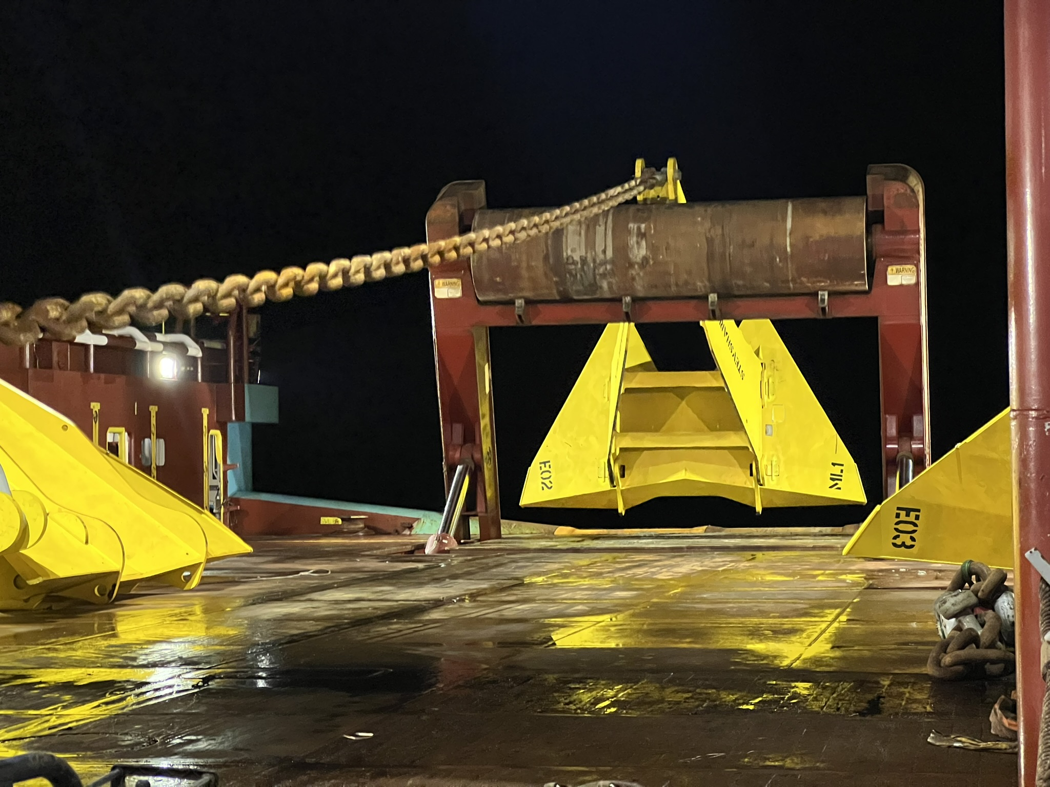
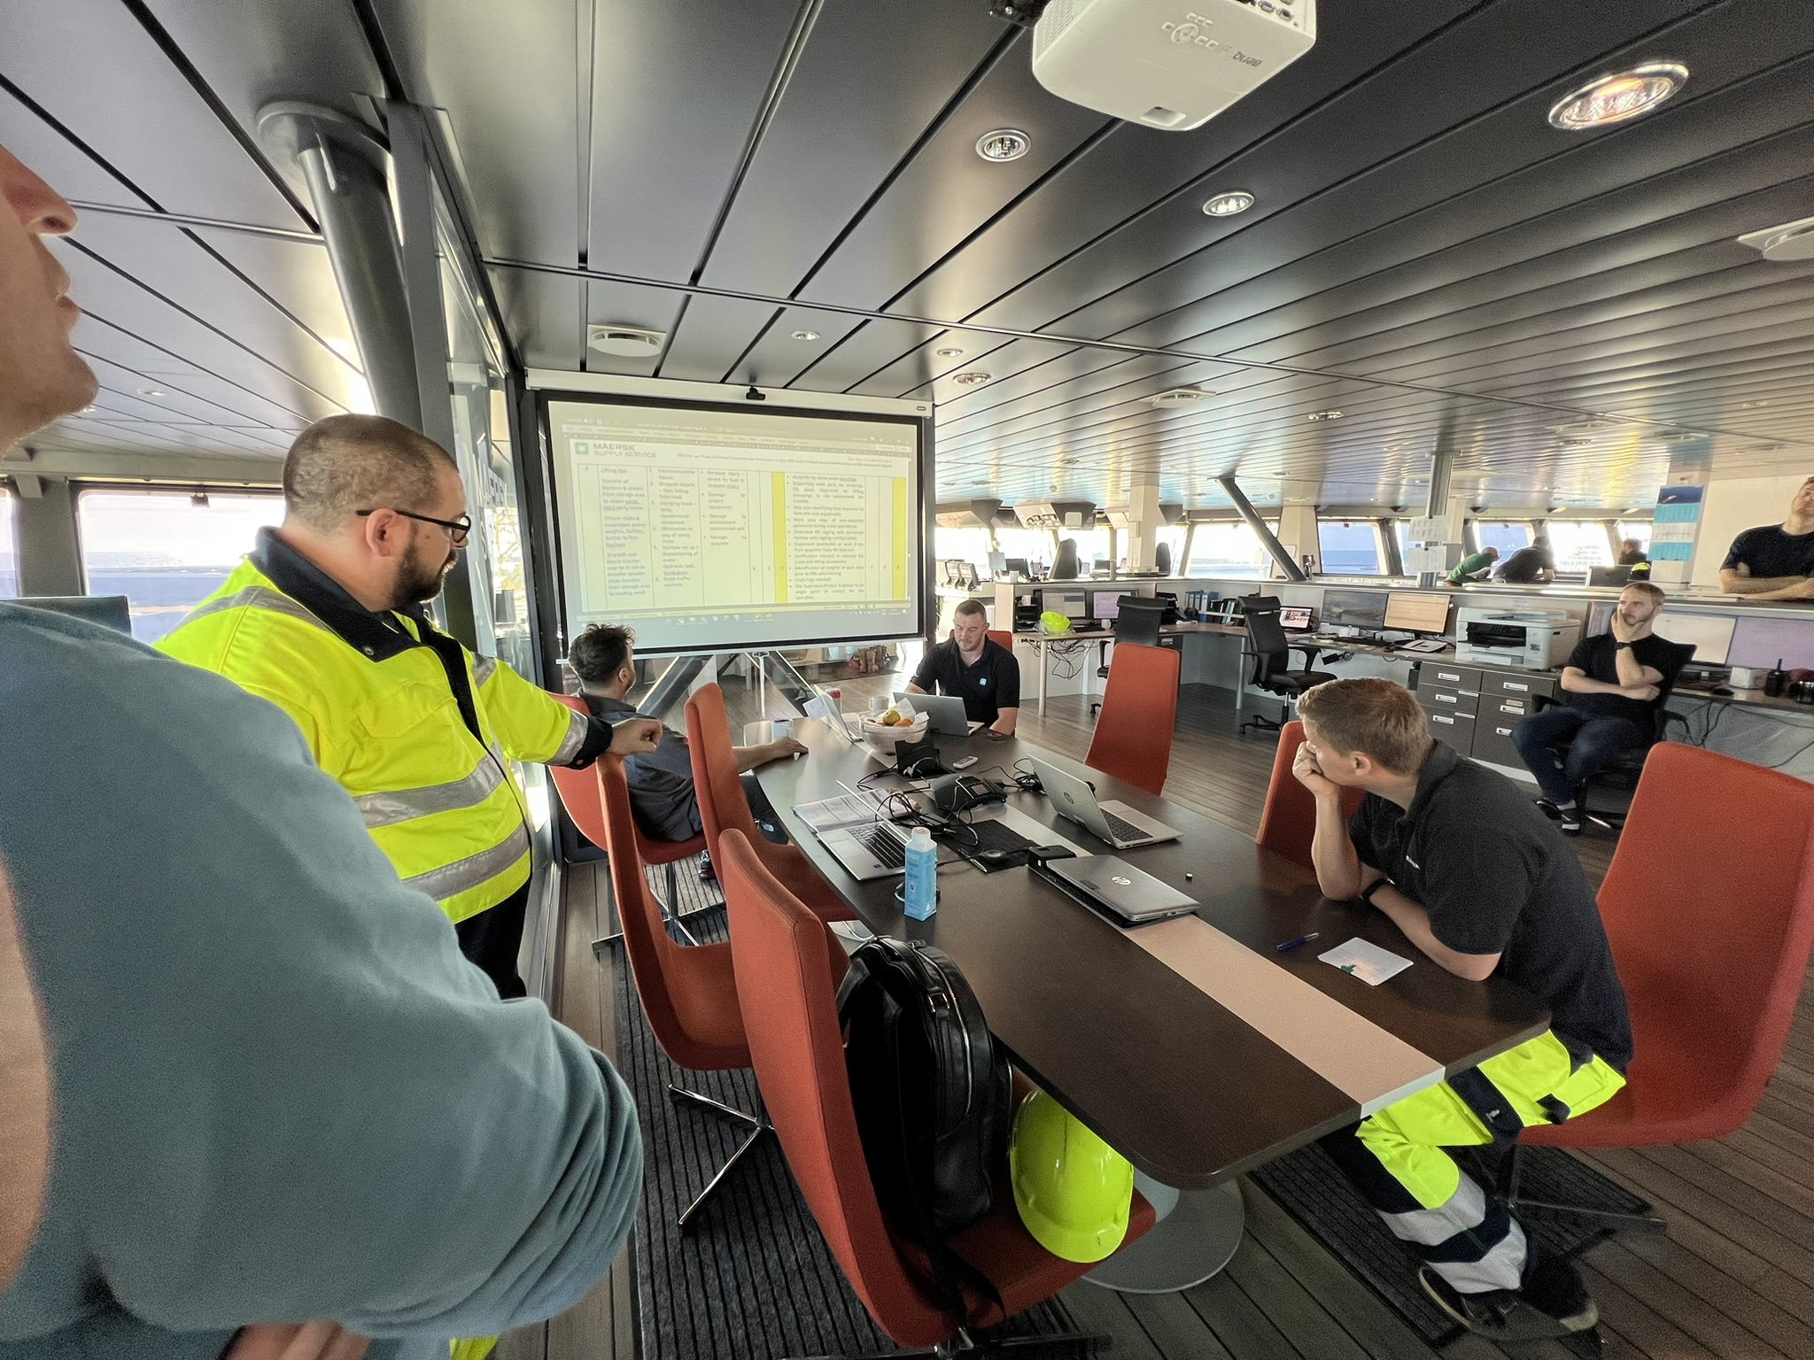
Moorings Installation – Case Study
  Mooring Prelay Operations
    Two phases of lines installation
      Drag anchors, clump weights & chain. Drag anchor proof loading (320t using Tandem Pull methodology)
      HMPE mooring line & PMC mandrel
  Tadek Input
    Mooring Prelay procedures
    As-built recording throughout operations
    Storyboards, site plans, deck layouts, task plans, lift plans
    On-site project engineering support
  Lessons Learned
    Vessel selection: gantry crane or aft deck crane would allow better equipment handling
    Learning curve with deploying certain components / installation aids / connections on deck
    Mooring system design / ground chain length very sensitive leading to lost time and potential risk
    Marine spread / timings were not complex – Phase 1 in 10 days, Phase 2 in 5.
17

Slide 18




Moorings Installation – Case Study
  Offshore Tow to Site
    Ballasting to installation draft & lift bag removal
    FWT towing from PLN to Installation Site
    Tow distance ~13nm
    Tadek Input
    Towing deliverables
      Bollard Pull & Towline Catenary calculations to DNV-ST-N001
      Marine spread specifications
      Tow Rigging Design & Draughting
      Passage planning with Master Mariners & local stakeholders
      Manoeuvre sketches and procedures
      Tow Manuals
    Lessons Learned
    Technicians for onboard equipment on standby
18

Slide 19




Moorings Installation – Case Study
  Hook-up Operations
      Receptacle seafastening removal
      Pick up of pre-laid PMC mandrels
      Handshake of pre-laid moorings between vessel & FWT
      Pull-in of mandrels into receptacles on FWT columns
    Tadek Input
    Field drawings & storyboards
    Positioning guides / target boxes for installation
      Inputs from on-board winch, tug limitations, fairlead capacities, and environment
    ROV / survey spread interface
    Recording & reporting of as-built data
    On-site project engineering throughout the operations
19

Slide 20




Moorings Installation – Case Study
    Hook-Up Lessons Learned
    PMC testing was important – adjustment rigging.
    Tight twist tolerances on HMPE ropes was difficult to achieve.
    Tadek design of installation aid to enhance operation.
    Weather buoy for weather monitoring.
    Crew Transfer limited operations.
    Most efficient hook-ups on WindFloat platforms ever achieved !
20

Slide 21
Conclusions and Perspectives

Slide 22
Conclusions and Perspectives
Synthetic ropes can provide better performance than steel components and have already significant track record in specific applications
Different types of synthetic rope with different properties, suitable for alternative applications (e.g. nylon for shallow water harsh environments, polyester for deep-water offshore moorings, HMPE for TLPs and mild)
Industry standards note the importance of re-tensioning and avoidance of seabed contact, is this still relevant with novel solutions?
Hybrid moorings with synthetic rope segments are technically feasible for floating wind and satisfy all design criteria in intact conditions
Offshore installation is sensitive to the requirement for seabed clearance and may require bespoke components
Tadek’s experience shows that HMPE removes need for re-tensioning but subject to strict tolerances and requires careful monitoring of twisting
Learning curves for floating wind mooring installation very steep -> potential of significant time savings in large scale wind farm
Development of bespoke quick-release connectors and terminations enabler for smoother installations

Slide 23
Naval Architects, Project Managers, Offshore & Subsea Engineers
Get in touch
+44 (0) 1483 971 583
hello@tadek.co.uk

